Slide 1

History of patient cases in Electronic Health Records
July 16th, 2019
Hokyun Jeon
1

Slide 2
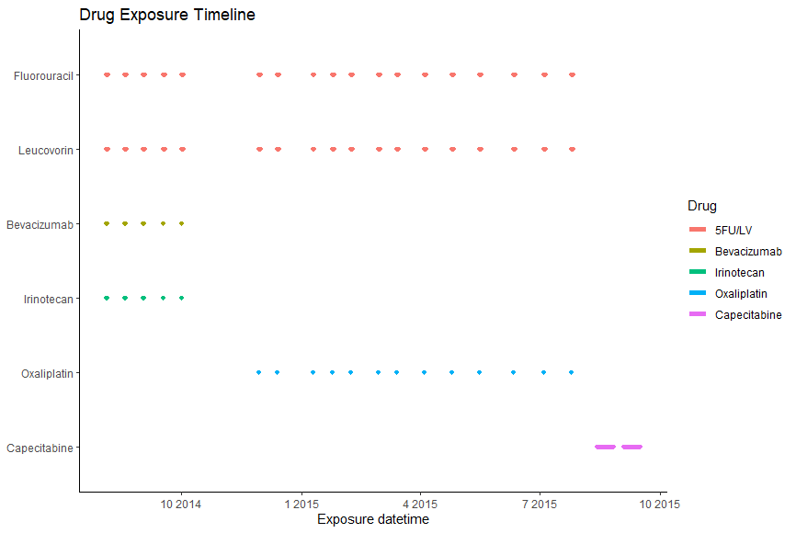
Case 1 : multiple treatment line in one patient history
most of patients who had multiple treatment line were in palliative therapy
Notes:
첫번째 case는 이러한 차트로 나타낼 수 있는데 2014년 8월 부터 2014년 말까지 5번의 FOLFIRI / bevacizumab ~

Slide 3
Case 1 : Patient information
61 years-old woman
sigmoid colon cancer and lung metastasis were suspected
For palliative therapy , Avastin & FOLFIRI were treated as first line and then get some test for EGFR or KRAS mutation and biopsy

Slide 4
Case 1 : Multiple treatment line in one patient history
Biopsy result were got after first treatment cycle
we should consider that drug exposure record could be in before the date of pathology result.
Notes:
why we should seperate drug regimen table in episode table.

Slide 5
Case 1 : Multiple treatment line in one patient history
biopsy result
Colon, 30cm from anal verge, Adenocarcinoma, moderately differentiated.
Which means sigmoid colon
Biopsy result could designate the topography of cancer in multiple format
Notes:
Biopsy result could designate the topography of cancer in multiple way

Slide 6
Case 1 : Multiple treatment line in one patient history
FOLFOX were used in second treatment line
Cecal perforation made change in treatment line
This kind of side effect could derive alteration in treatment regimen

Slide 7
Case 1 : Multiple treatment line in one patient history
Cycle interval could be changed in many reasons
In FOLFOX cycle, third cycle were delayed due to herpes zoster
6th cycle were delayed one week for national holiday
Total 13 cycle of FOLFOX were treated for 8 months

Slide 8
Case 1 : Multiple treatment line in one patient history
Three cycle of capecitabine were prescribed before he expired
Three cycles of capecitabine were in drug exposure table, but he couldn’t get last one.

Slide 9
Case 2 : patient history with radiotherapy and surgery
A patient who had surgery for rectal cancer in 1994
There are no EHR records in this era, so it could be hard to recognize that following disease occurrence as relapse
Notes:
과거 기록의 경우 emr data에 drug이나 관련 정보가 없을 수 있음,
2013년의 rectal cancer 의 발생이 재발인지 첫번째 발생인지 판단하기 어려울 수 있다.
또한 같은 약물이 처리되더라도 수술 전과 수술후의 요법을 구분하는 것이 의미가 있는지 고려해보아야한다.

Slide 10
Case 2 : patient history with radiotherapy and surgery
In 2013, rectal cancer was relapsed and after two cycle of Fluorouracil & leucovorin with radiotherapy, patients had got surgery
After surgery, 4 cycle of Fluorouracil & leucovorin were treated with radiotherapy
It is hard to separate these treatment as different type of treatment (neo-adjuvant/adjuvant) with only drug exposure data

Slide 11
Case 2 : patient history with radiotherapy and surgery
In 2017, rectal cancer were recurred with multiple bone metastasis
and FOLFOX were treated in 9 cycles
Treatment regimen could be changed after relapse, but we can not
convinced that treatment regimen alteration means recurrence
After 9 cycles of FOLFOX , he expired in palliative care unit
Notes:
Treatment regimen의 변경이 다음 상황과 같이 재발을 나타내는 경우도 있으나, 짧은 간격을 두고 일어나는 treatment line의 변화의 경우 이렇다고 단정할 수 없다.

